Slide 1
Exploring alternative methods for distinguishing between different groups of snow crab in the field
Determining carapace condition from field photos or near-infrared spectroscopy using statistical methods or AI
Notes:
The chromameter is a tool for precise and objective assessment of surface color

Slide 2
Background
Snow crab grow by periodically shedding their old, smaller, hard shell and forming a new, larger and soft shell, which subsequently hardens over time. With respect to managing the snow crab fishery, it is important to distinguish soft-shelled crab for two reasons:
To quantify recruitment to the fishery, which is used for modeling the dynamics of the snow crab population and determining the status of the commercial stock.
To estimate the quantity of soft-shelled crab being caught by fishermen. Soft-shelled crab are of no commercial value, but are vulnerable to mortality even when fishermen return them to the water.
Currently, soft-shelled crab are distinguished using a number of subjective external characteristics of the crab’s shell, such as colour, opacity, iridescence, or the quantity of surface organisms on the crab shell. Training and field testing is required to achieve the desired level of consistency between field samplers, with varying levels of success. The task is further complicated by the fact that the external appearance of crab varies between different locations and over the field season, creating uncertainty as to the reliability of these observations. Thus, there is a need of a way objectively distinguish between soft and hard-shelled crab in the field.

Slide 3
Objectives
Gather a dataset on individual snow crab which contains both traditional measurements and observations, as well as new measurements relating to different material properties of snow crab.
Examine the relationships between the new and old observations, with a special focus on distinguishing between new and old crab, i.e. soft and hard crab, in the field.

Slide 4
Methods
When : Early september, 2023.
Where : Off the coast of Cheticamp.
Vessel : CCGS M. Perley.
Gear : Small fine-meshed conical snow crab traps.
Sampling target : Male snow crab, stratified by size, maturity and carapace condition.

Slide 5
Methods
For each sampled snow crab, apply the following suite of measurements :
Standard measurements and observations (carapace and chela size, carapace condition, etc.).
Colorimeter (chela and merus).
Near-infrared field spectrometer (Tellspec NIR) (chela and merus).
Durometer (chela).
Refractometer on a small hemolymph sample.
Photos (ventral and dorsal, chela time permitting).
Meat content (from samples brought to the lab).

Slide 6
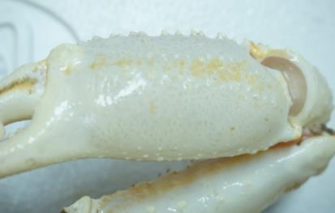
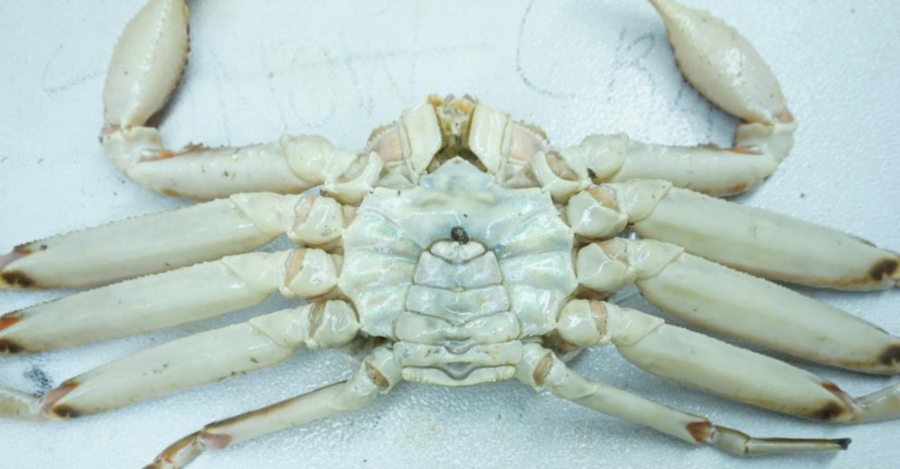
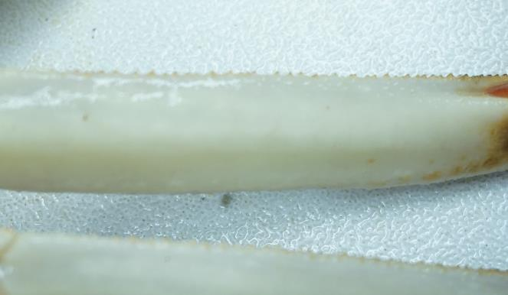
Crab measurement locations
Chela
Merus
Ventral view

Slide 7
Measurements
Standard crab measurements:
Carapace width & chela height.
Sex & maturity.
Misssing leg pattern.
Carapace condition.

Slide 8
TellSpec Near-infrared (NIR) Spectrometer
Prepare new project on IPad
Connect NIR and complete 3-4 scans to warm up machine
Scan areas of crab: leg (merus of 2nd pereopod) and chela; repeat each area 3 times
Take colorimeter reading (merus of 2nd pereopod and chela)
Take durometer reading (chela)
Take hemolymph sample
Sample leg that was scanned by cutting it with shears and freeze in ziplock (joint of leg should be sprayed with 70% ethanol before and after leg cutting).
Notes:
The chromameter is a tool for precise and objective assessment of surface color

Slide 9
Hemolymph sampling
Spray area of hemolymph sampling with 70% ETOH
Area of sampling: distal dorsal carapace, take picture
Using a 5ml syringe, sample 2-3 ml of hemolymph
Place 1-2 drops on refractometer;
Read and record protein amount
Clean refractometer with distilled water and Kim wipes
Notes:
The chromameter is a tool for precise and objective assessment of surface color

Slide 10
Equipment
IPad (data entry).
Calipers.
Tellspec Near-infrared Spectrometer (NIR) (+ cling wrap).
Colorimeter (+ alcohol swabs for cleaning).
Durometer (preferably calibrated).
Refractometer (+ needles, alcohol spray bottle)
Laboratory samples:
Ziplocks bags for merus samples (+ access to freezer).
Chargers for various devices.
Dissection tools.
Stationary (pencils, erasers, …)
Shop towels.

Slide 11

Sampling stratification
Male snow crab only.
Maximum of 5 crab per category.
Categories stratified by:
Maturity (morphometrically immature and mature).
Carapace condition (1&2 grouped together, then 3, 4 and 5).
Size (10 mm size bins).
75-84 mm, 85-94 mm, 95-104 mm, 105-115 mm, and 115 + mm. Carapace width.
Dorsal view
Ventral view

Slide 12
Sampling stratification
 | Carapace Condition (immature)
Size Class | 1-2 | 3 | 4 | 5
75-84 mm
85-94 mm
95-104 mm
105-114 mm
115-124 mm
 | Carapace Condition (mature)
Size Class | 1-2 | 3 | 4 | 5
75-84 mm
85-94 mm
95-104 mm
105-114 mm
115-124 mm

